Slide 1

Introduction of ZWCS
(ZimVie Warehouse Control System)

Slide 2
Outline
I. Login and Main Menu Structure
Each Function
a. Import Shipping Notice
b. Re-Print Product Labels
c. Synchronize Item Master with Kintone
d. Verify Product Labeling
III. System Settings
e. Source Code Management
f. Application File Deployment
g. Database Server Setting

Slide 3
Outline
I. Login and Main Menu Structure
Each Function
a. Import Shipping Notice
b. Re-Print Product Labels
c. Synchronize Item Master with Kintone
d. Verify Product Labeling
III. System Settings
e. Source Code Management
f. Application File Deployment
g. Database Server Setting

Slide 4
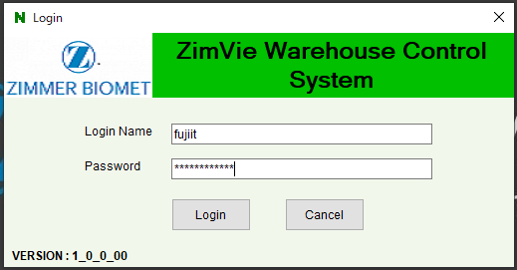
Login
Even though user authentication and role & responsibility control functions are implemented, it is turned off to minimize the complexity in operation, considering that most of the users of this application are logistics partner employee. Currently, user can log in by typing any letters in user name text box and password text box.

Slide 5
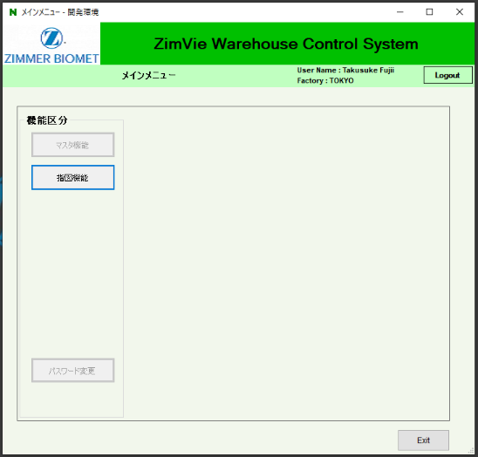
Main Menu
Maser maintenance menus such as user - role & responsibility masters are disabled, so is the password change menu. Currently, only the work order related menus are set as available.
Master Maintenance
Log Out
Work Order
Pass Word Change
Exit

Slide 6
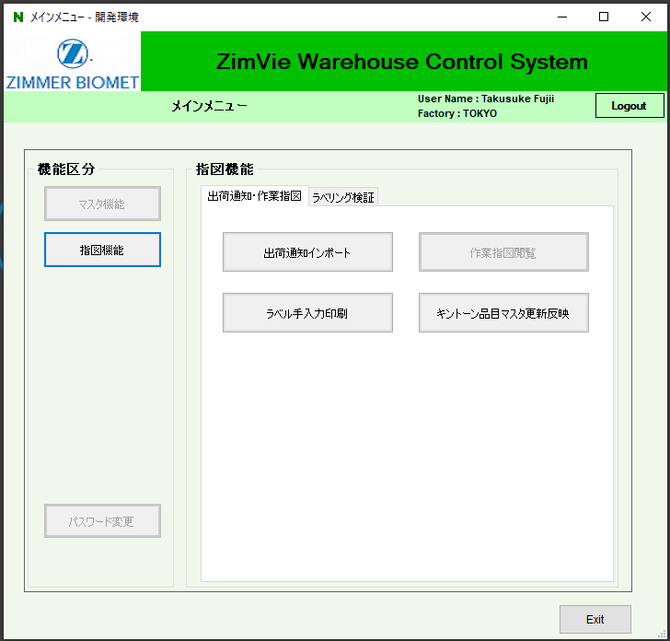
Main Menu first tab: Shipping Notice & Work Order
Work order menu consists with 2 tabs:
Shipping Notice & Work Order
Product Labeling Verification
1. Shipping Notice & Work Order tab provides 3 functions:
a. Import Shipping Notice
b. Re-Print Product Labels
c. Synchronize Item Master
a. Import Shipping Notice does:
Convert shipping notice into work order and product label
b. Re-Print Product Labels does:
Let user manually print product label
c. Synchronize Item Master:
Synchronize local item master with Kintone item master
1. Shipping Notice
& Work Order
2. Product Labeling Verification
a. Import Shipping Notice
b. Re-Print Product Labels
c. Synchronize Item Master with Kintone Cloud Application (Japan Intra Company Portal)

Slide 7
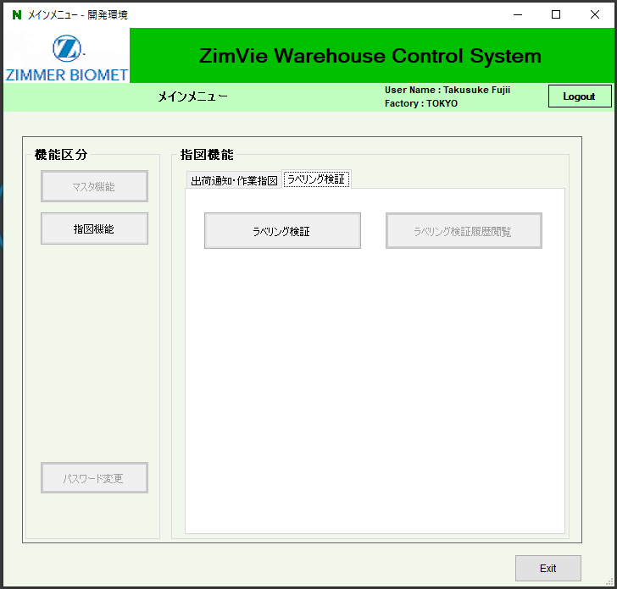
Main Menu second tab: Product Labeling Verification
Work order menu consists with 2 tabs:
Shipping Notice & Work Order
Product Labeling Verification
2. Product Labeling Verification tab provides 2 functions:
d. Verify Product Labeling
e. View Verification History
d. Verify Product Labeling does:
Convert shipping notice into work order and product label
e. View Verification History does:
Let user manually print product label
2. Product Labeling Verification
d. Verify Product Labeling
e. View Verification History

Slide 8
Outline
I. Login and Main Menu Structure
Each Function
a. Import Shipping Notice
b. Re-Print Product Labels
c. Synchronize Item Master with Kintone
d. Verify Product Labeling
III. System Settings
e. Source Code Management
f. Application File Deployment
g. Database Server Setting

Slide 9
a. Import Shipping Notice
a. Import Shipping Notice

Slide 10
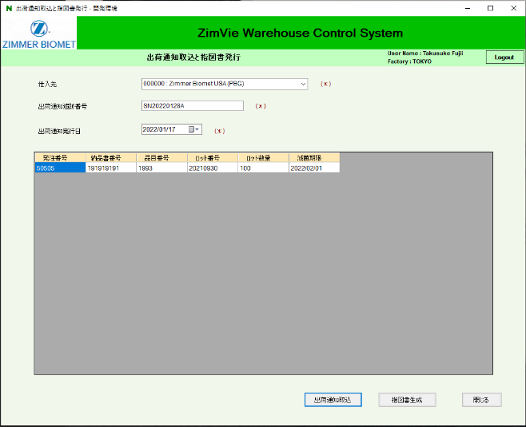
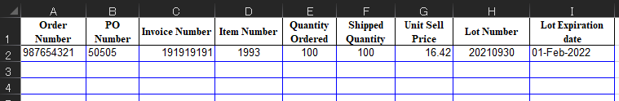
a. Import Shipping Notice
Import Shipping Notice Screen provide the below two functions:
α. Import shipping notice excel file
then display its details.
β. Generate & print work orders,
then print product labels.
Select supplier
Input shipping notice number
Select shipping notice date
α. Import shipping notice excel file
β. Generate & print work orders, then print product labels for each order
“Shipping notice” here refers to “COC: certificate of conformance” sent from PBG or the “ASN: advance shipping notice” sent from the 3rd party suppliers.

Slide 11
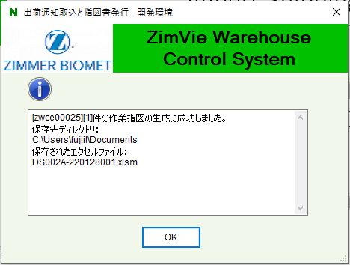
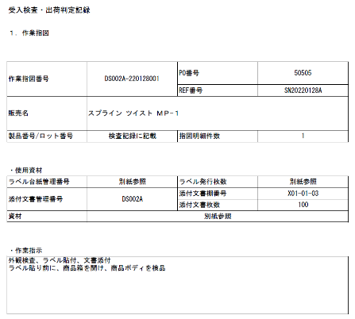
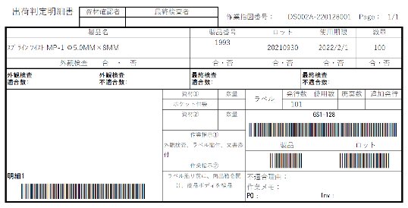
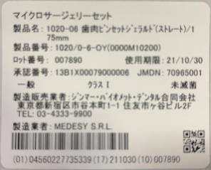
a. Import Shipping Notice
The result of clicking the button "β. Generate & print work orders, then print product labels“
Work order Excel file is generated in My Document directory.
Work order papers are printed from ordinary document printer
Product labels are printed from barcode printer

Slide 12
Outline
I. Login and Main Menu Structure
Each Function
a. Import Shipping Notice
b. Re-Print Product Labels
c. Synchronize Item Master with Kintone
d. Verify Product Labeling
III. System Settings
e. Source Code Management
f. Application File Deployment
g. Database Server Setting

Slide 13
b. Re-Print Product Labels
b. Re-Print Product Labels

Slide 14
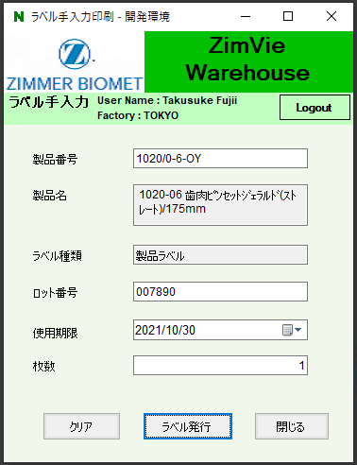
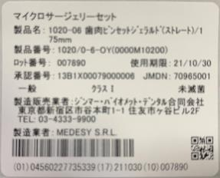
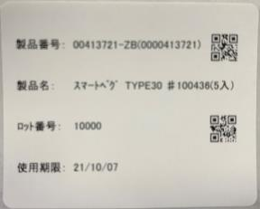
b. Re-Print Product Labels
Product label re-printing function is available for the case of labels lost or misprinted.
There are two types of label: ordinary product label, internal-purpose logistic label.
Ordinary product label
Input item number
Input description displayed from item master
Label type displayed from item master
Input lot number
Select expiry date
Input label quantity
Send print command to the barcode printer
Internal-purpose logistic label

Slide 15
Outline
I. Login and Main Menu Structure
Each Function
a. Import Shipping Notice
b. Re-Print Product Labels
c. Synchronize Item Master with Kintone
d. Verify Product Labeling
III. System Settings
e. Source Code Management
f. Application File Deployment
g. Database Server Setting

Slide 16
c. Synchronize Item Master with Kintone
c. Synchronize Item Master with Kintone Cloud Application (Japan Intra Company Portal)

Slide 17




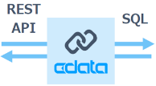

c. Synchronize Item Master with Kintone
For Japan regulatory and logistics management purpose, Japan local item master data is controlled in Kintone application. ZWCS main desktop application runs in warehouse on-site PC with Postgres DBMS. RA and Logistics leader members manage item master in Kintone which is synchronized to ZWCS main application and database. Incidentally, work order - product label verification operation is done by manufacturing members accessing the database from each manufacturing PC.
Internet
Kintone item master cloud application
ZWCS main desktop application and database
Internet
CDATA
middleware
Company network
RA leader
LOG leader
Manufacturing members

Slide 18
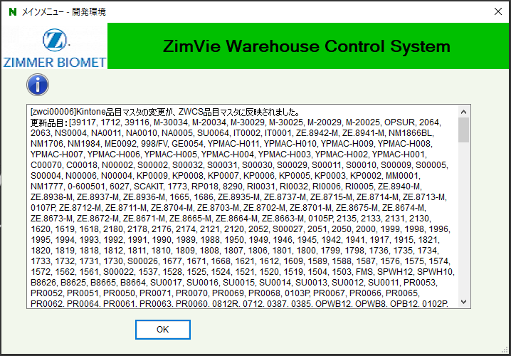
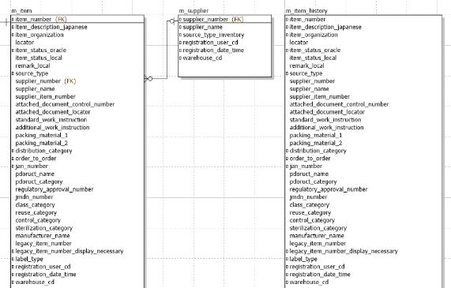
c. Synchronize Item Master with Kintone
When the Synchronize button is clicked in the main desktop application, the application read Kintone data for necessary update or creation, then update or create the record in the local database if the target item records exists. The local master record history is stored in the database for every update or create.
Synchronization result is displayed as the message to the user.
Not only the latest item master records but also every update or create history is stored in the local database.

Slide 19
Outline
I. Login and Main Menu Structure
Each Function
a. Import Shipping Notice
b. Re-Print Product Labels
c. Synchronize Item Master with Kintone
d. Verify Product Labeling
III. System Settings
e. Source Code Management
f. Application File Deployment
g. Database Server Setting

Slide 20
d. Verify Product Labeling
d. Verify Product Labeling

Slide 21

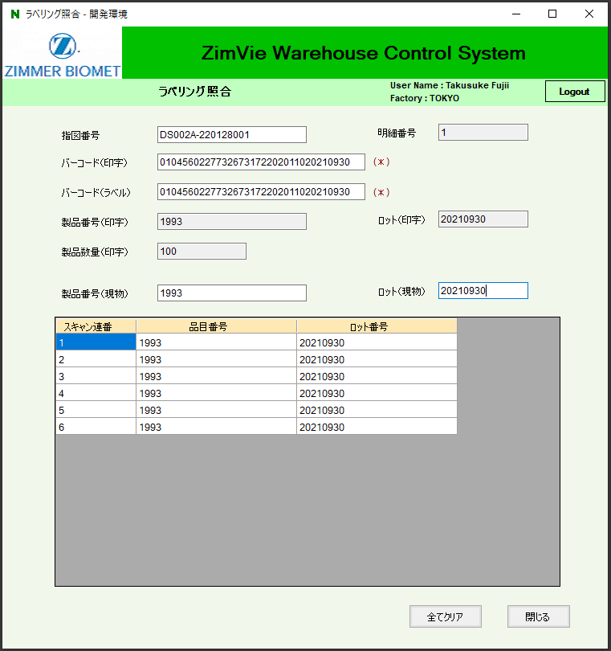
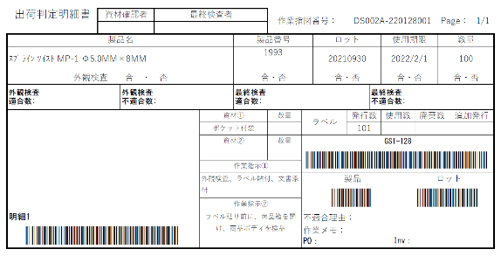
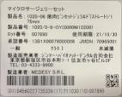
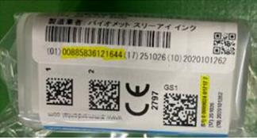
d. Verify Product Labeling
α. Work order no
α. Work order line no
β. Scan work order product label barcode
β. Product label barcode
γ. Product label barcode
δ. item no
ε. Lot no
α. Scan work order line info: order no, line no, and quantity
γ. Scan actually printed product label barcode. One actual label is pasted onto the order paper as the label accuracy evidence.
Each product is scanned for its item no and lot no. If a product does not match to the work order line info, error message is displayed, error log in recorded, and the operation is locked to let the user investigate the difference. Once the product scan count reach the work order line quantity, the application record the verification as success for the order line.
δ. Scan item no barcode on the product
ε. Scan lot no barcode on the product

Slide 22
Outline
I. Login and Main Menu Structure
Each Function
a. Import Shipping Notice
b. Re-Print Product Labels
c. Synchronize Item Master with Kintone
d. Verify Product Labeling
III. System Settings
e. Source Code Management
f. Application File Deployment
g. Database Server Setting

Slide 23
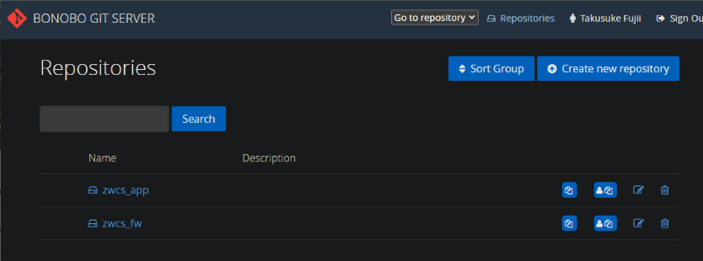
e. Source Code Management
ZWCS source code consists of two solutions. One is “Framework” solution which contains base objects to control database transaction, business logic abstraction, and UI design. The other one is “Application” solution which contains implementation objects to actually describe the ZWCS specific business logics and UI forms.
Framework repository: http://euesv-app-p67/Bonobo/zwcs_fw.git
Application repository: http://euesv-app-p67/Bonobo/zwcs_app.git

Slide 24
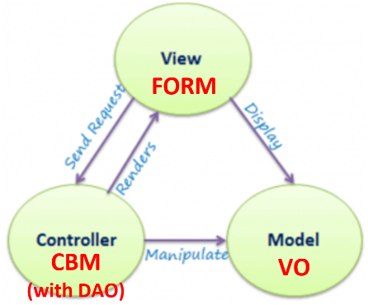
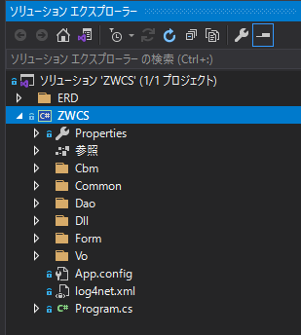
e. Source Code Management
ZWCS is a Windows Forms application applying MVC architecture.
Value Object (Model) : Defines data structure
Form (View) : Defines display
Core Business Module (Controller) : Contains control logic (usually with one or more DAO)
Data Access Object : Contains database command (usually SQL command)
* Each object in the solution is stored to the corresponding folders.

Slide 25
Outline
I. Login and Main Menu Structure
Each Function
a. Import Shipping Notice
b. Re-Print Product Labels
c. Synchronize Item Master with Kintone
d. Verify Product Labeling
III. System Settings
e. Source Code Management
f. Application File Deployment
g. Database Server Setting

Slide 26
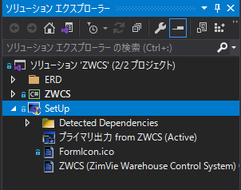
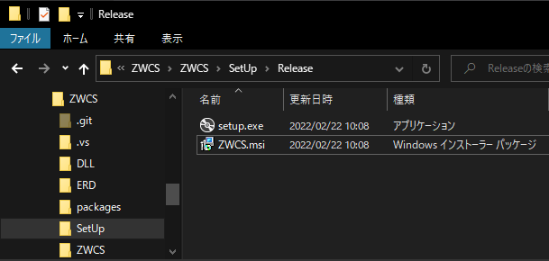
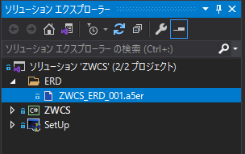
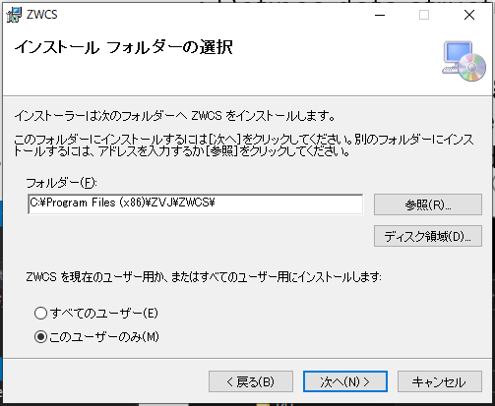
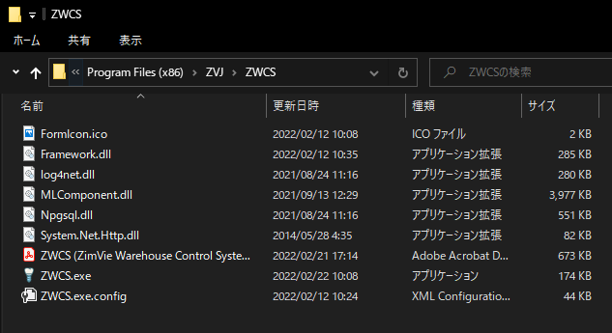
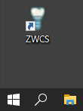
f. Application File Deployment
ZWCS solution has Windows Installer project “SetUp”. By building this project, the installer file is created. Its execution on user’s PC results in the app’s installment to the path “C:\Program Files (x86)\ZVJ\ZWCS”, with short cut to the desktop and start menu.

Slide 27
Outline
I. Login and Main Menu Structure
Each Function
a. Import Shipping Notice
b. Re-Print Product Labels
c. Synchronize Item Master with Kintone
d. Verify Product Labeling
III. System Settings
e. Source Code Management
f. Application File Deployment
g. Database Server Setting

Slide 28
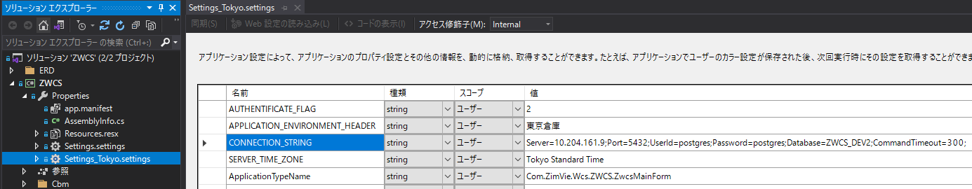


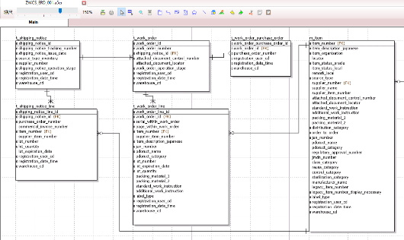

g. Database Server Setting
ZWCS is using opensource PostgreSQL 9.6 as its database. The IP address of the database can be adjusted in the setting file of ZWCS project. The database design is stored in “a5er” file in the ZWCS solution using “A5:SQL Mk-2” free tool. The tool can generate DDL(data definition language) from the ERD (entity relationship diagram).

